Slide 1

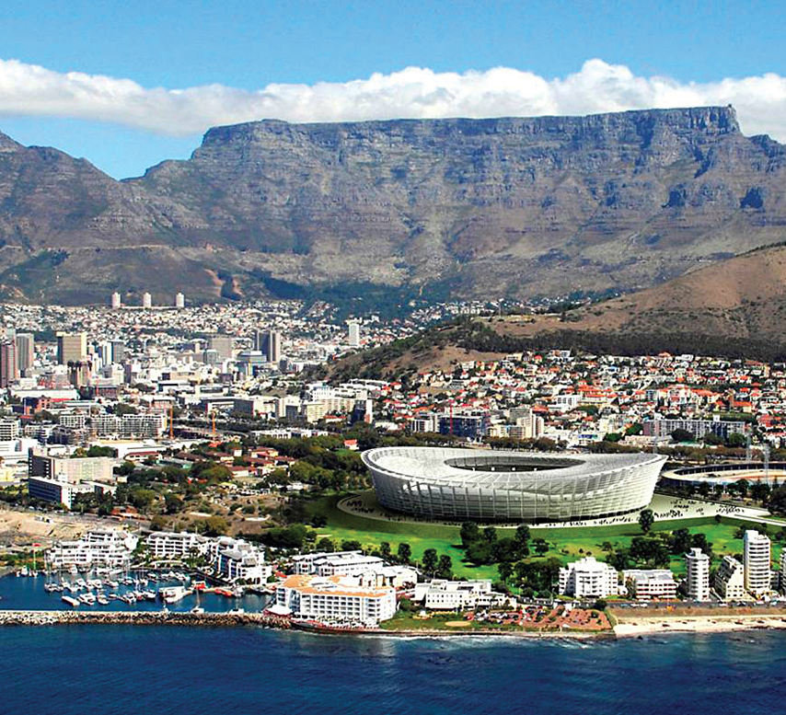
Airbnb:Capetown
Kwasi Arhin

Slide 2
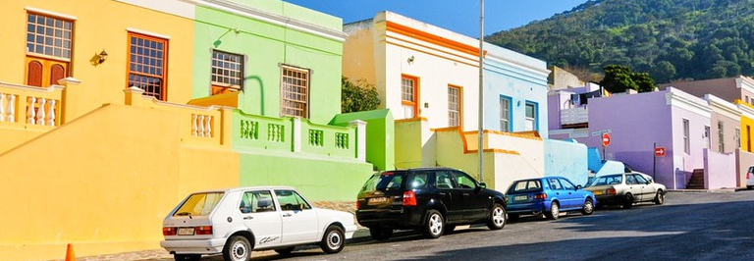

Intro
Goal: Use Airbnb listing to help predict price
Notes:
1.Host
2.Travelers
3.Investors

Slide 3
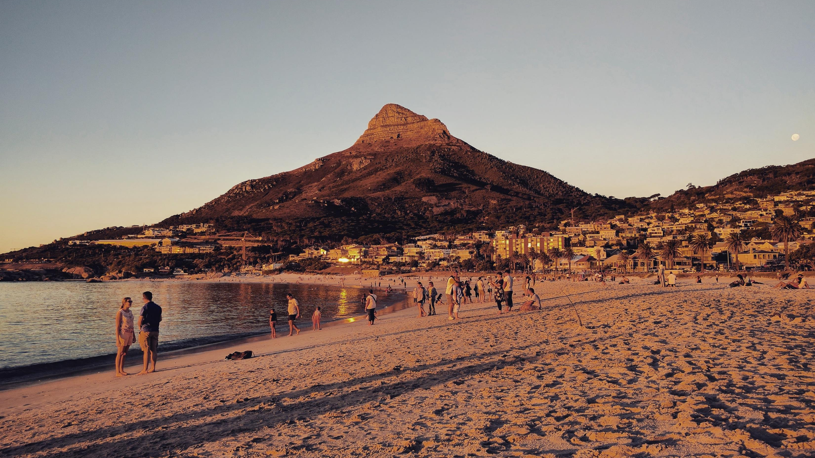
Methodology
Dataset: InsideAirbnb.com
Models Used:
Linear Regression:OLS:.71
Ensemble: XGBoost :.75
This Photo by Unknown Author is licensed under CC BY
Notes:
Cleaning
Dataset was a huge hurdle lots of things had to be tidied up, always remember to check the currecency.
XGBoost and linear regression…ensemble modeling of xgboost is superior

Slide 4
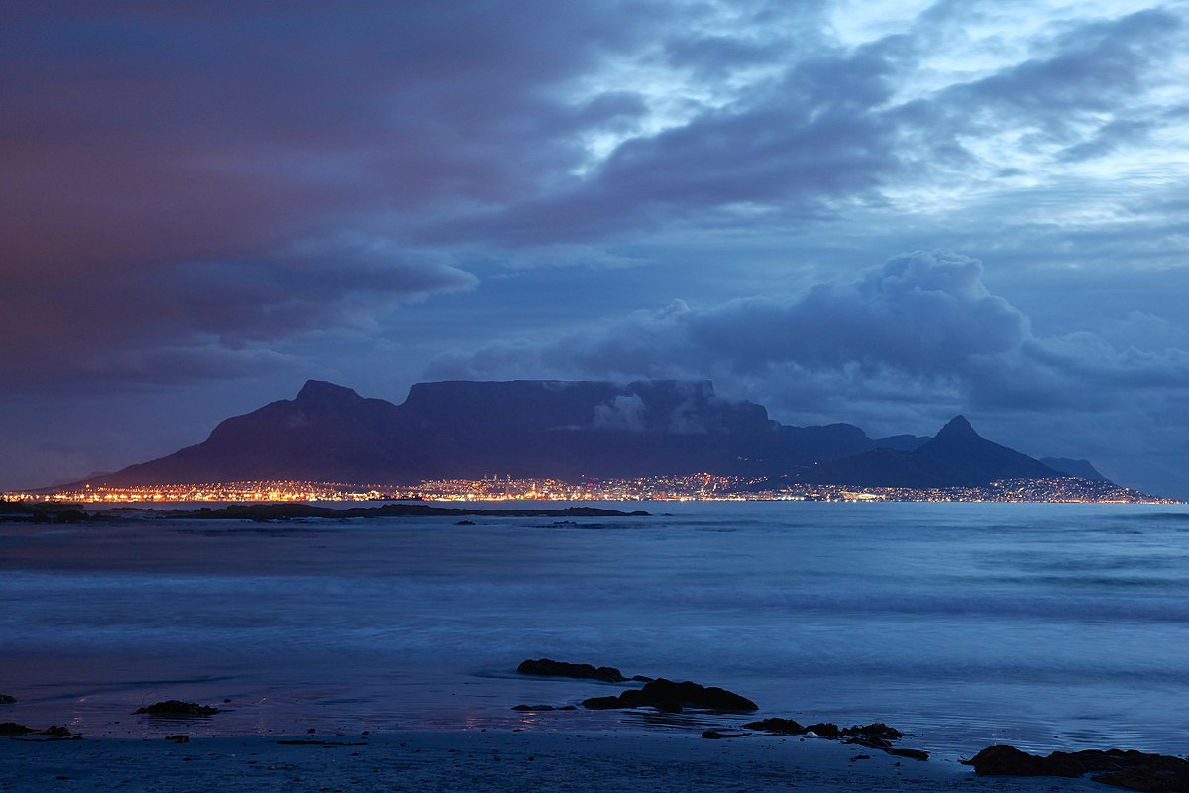

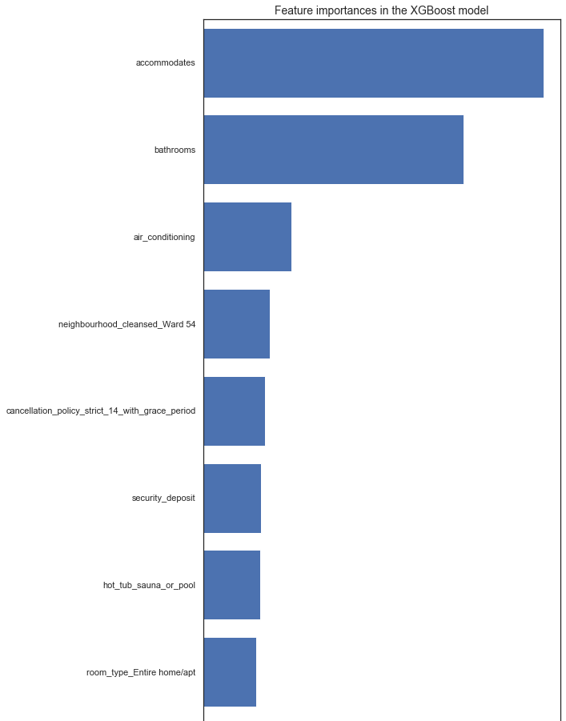
Top Features
Capacity
Bathrooms
Air Conditioning
Location:Ward 54
Cancelation Policy
Hot Tub or Pool
Room Type
Notes:
Cannot figure out where the ward 54 is

Slide 5
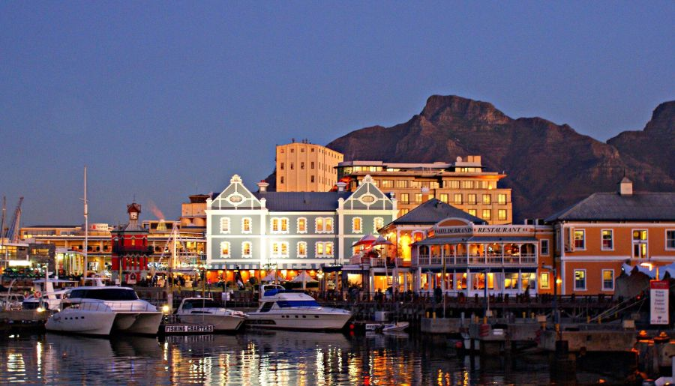
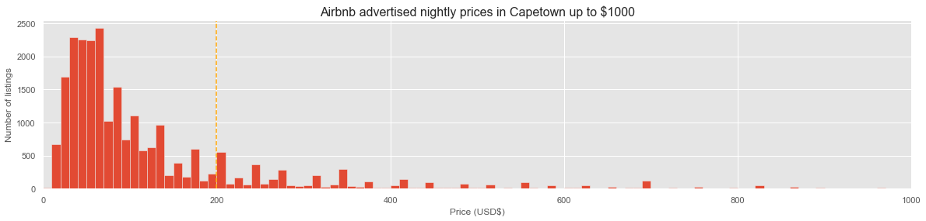
Notes:
Bulk of listings is under 200 .. Pareto distribution

Slide 6
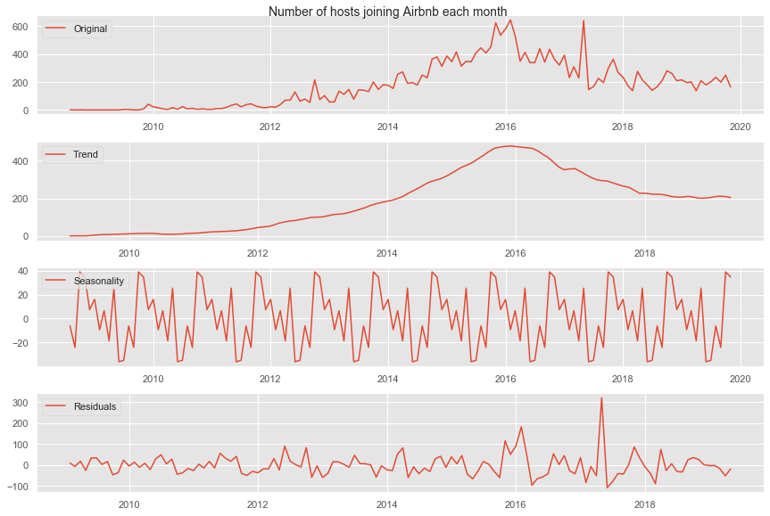
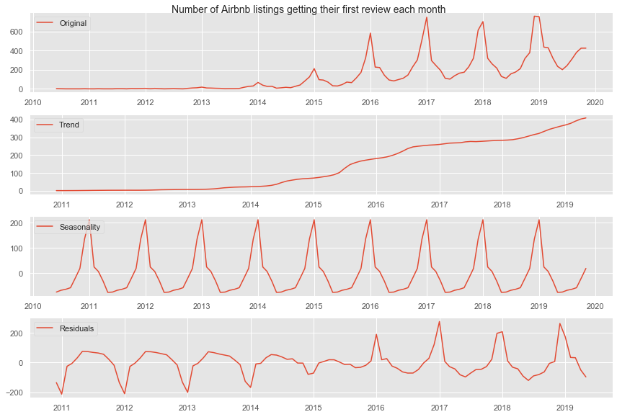
Seasonality
Notes:
Southern hempshiter completely opposite climeate thean us good to keep in mind their summer is our winter

Slide 7

What Else can be done
Text Analysis!!
Crime data
Computer Vision
Comparison to other cities
Notes:
Mention every single and why they would be important
Text for reviews
Crime Data- may affect viability of place
Computer visions- to gauge luxury
Comparison to other cities – For travelrs and business opeople alike

Slide 8
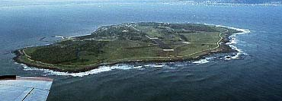
Questions?
This Photo by Unknown Author is licensed under CC BY-SA-NC
Notes:
Ask question about famous island

